Slide 1
The Document Object Model

Slide 2
What is DOM?
The Document Object Model (DOM) is a cross-platform and language-independent application programming interface.(API)
The DOM, is the API through which JavaScript interacts with content within a website.
The DOM API is used to access, traverse and manipulate HTML and XML documents.
The DOM is a W3C (World Wide Web Consortium) standard.

Slide 3
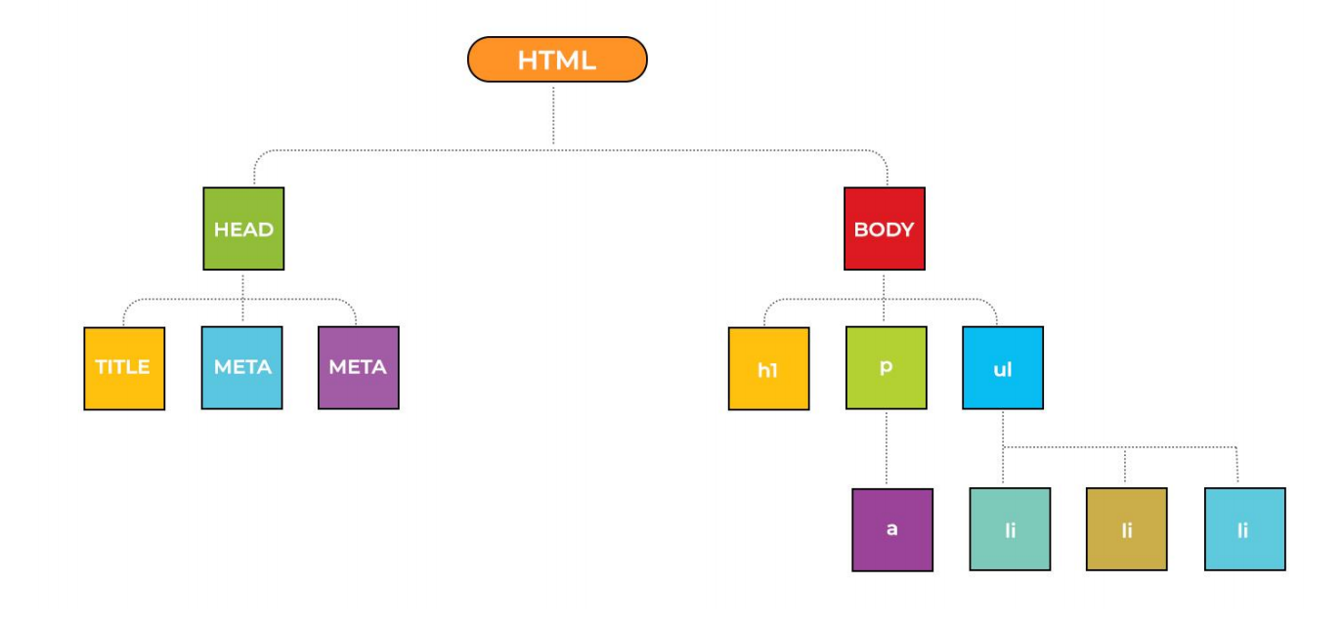
HTML DOM Tree Objects

Slide 4
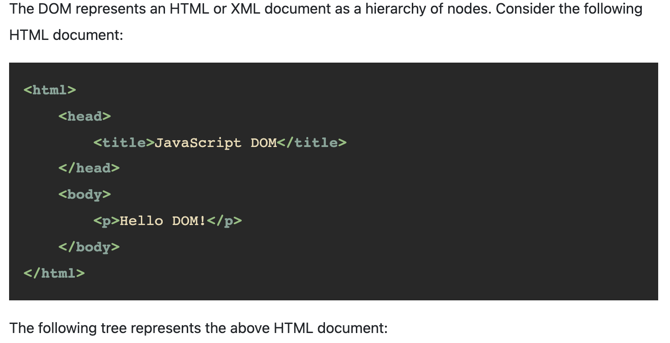

Slide 5
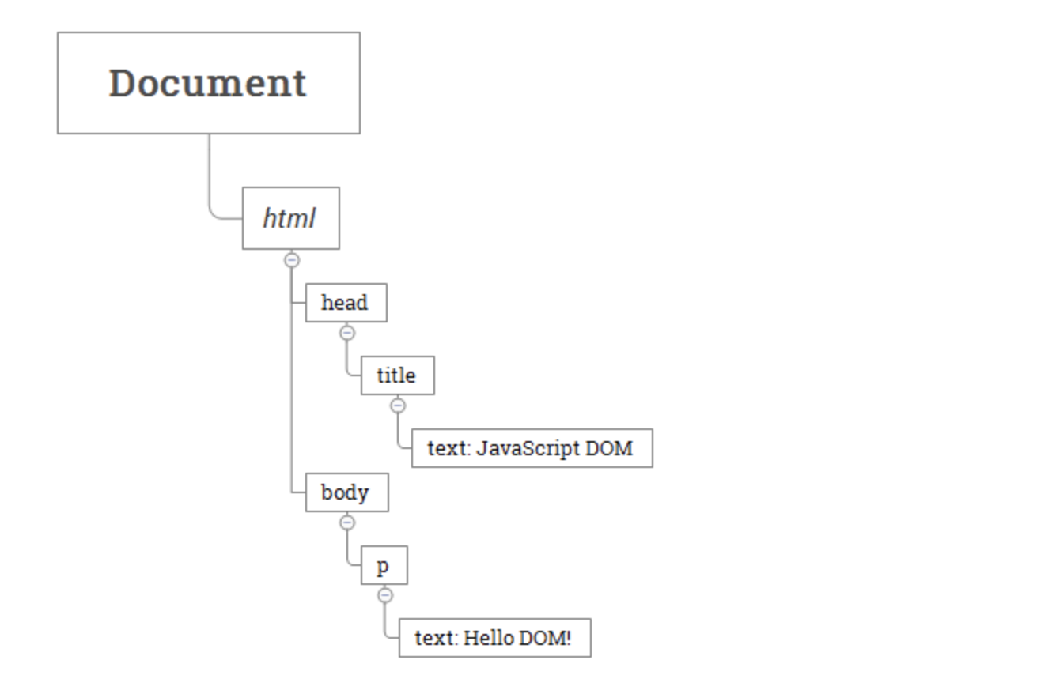
Tree Represents HTML Document

Slide 6
DOM Methods
getElementById()
Accesses any element on the page via its ID attribute • A fundamental method within the DOM for accessing elements on the page •
This method will return single element innerHTML •
The innerHTML is used to get and replace the content of HTML elements.

Slide 7
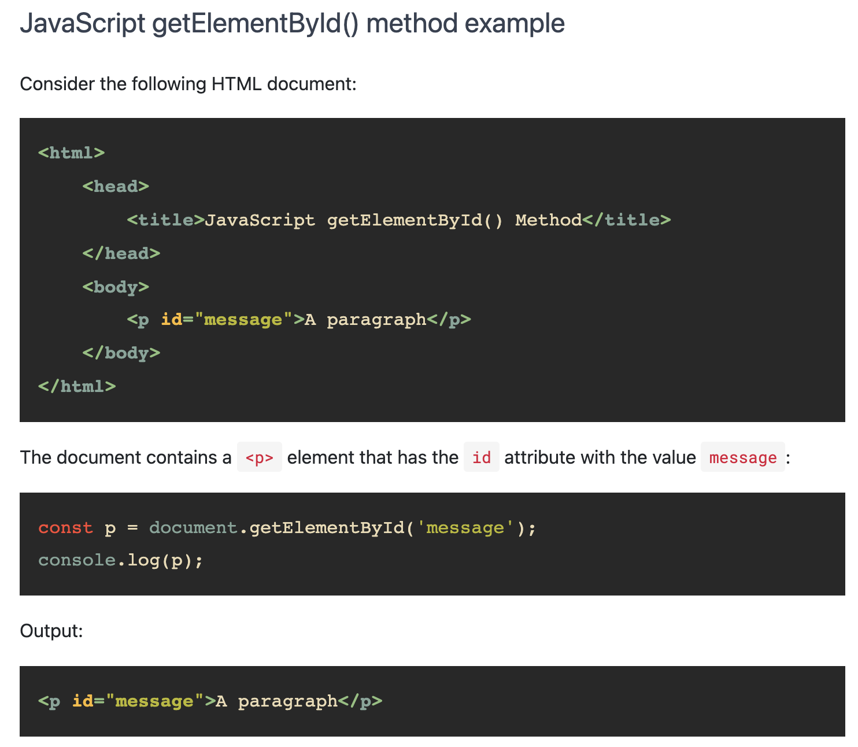

Slide 8
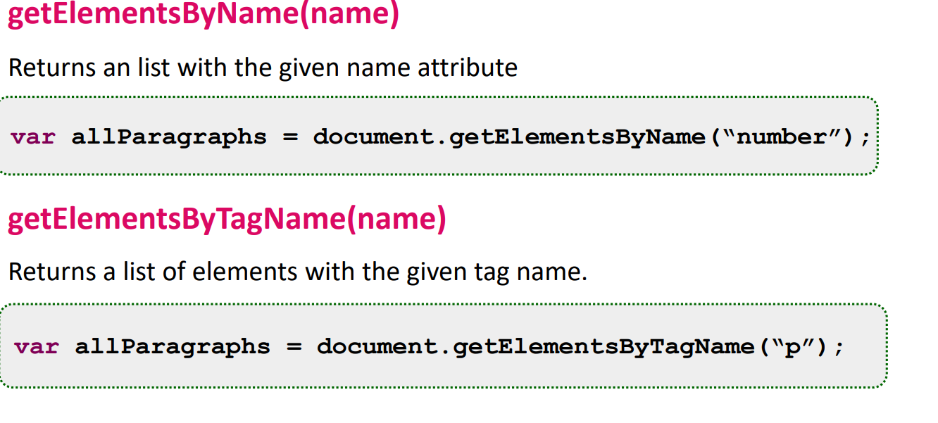
DOM Element

Slide 9
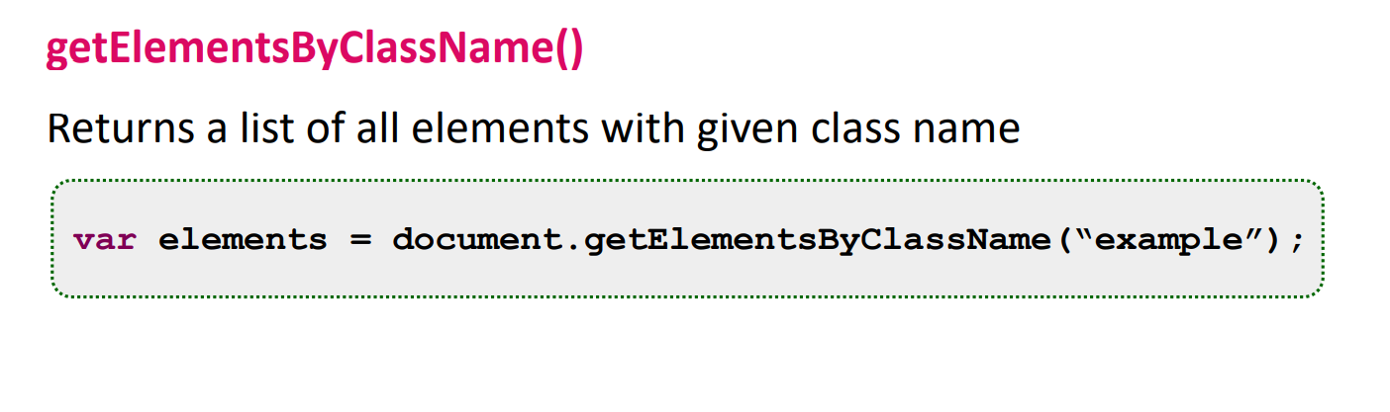
Element by class name

Slide 10
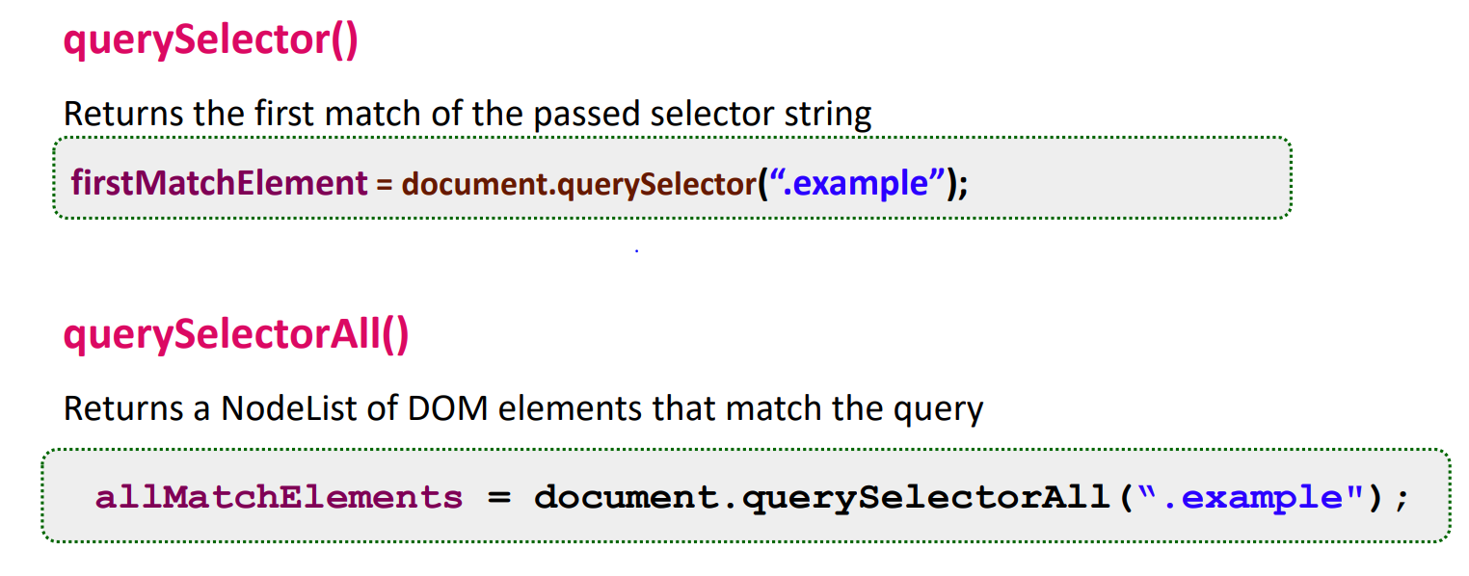
Elements by CSS Selectors

Slide 11
What is the Difference Between textContents, innerText, and innerHtml
textContents is all text contained by an element and all its children that are for formatting purposes only.
innerText returns all text contained by an element and all its child elements.
innerHtml returns all text, including HTML tags, that is contained by an element.
What is the Difference Between textContents, innerText, and innerHtml

Slide 12
<p>One</p>
<p>Two</p>
<p>Three</p>
<script>
let paragraphs = document.body.getElementsByTagName("p");
document.body.insertBefore(paragraphs[2], paragraphs[0]);
</script>

Slide 13
Styling
<p id="para" style="color: purple">
Nice text
</p>
<script>
let para = document.getElementById("para");
para.style.color = "magenta";
paragraph.style.background = "#875673";
paragraph.style.fontFamily = "Poppins";
</script>

Slide 14
Query selectors
The querySelectorAll method, which is defined both on the document object and on element nodes, takes a selector string and returns a NodeList containing all the elements that it matches.

Slide 15
<p>And if you go chasing
<span class="animal">rabbits</span></p>
<p>And you know you're going to fall</p>
<p>Tell 'em a <span class="character">hookah smoking
<span class="animal">caterpillar</span></span></p>
<p>Has given you the call</p>
<script>

Slide 16
<script>
let byclass = document.querySelector(".animal");
let byId = document.querySelector("#character");
let byTagName = document.querySelector("p");
byclass.style.color = '#8DE3BC';
byId.style.background = "#000";
byTagName.style.background = "#000232"
</script>

Slide 17
function count(selector) {
return document.querySelectorAll(selector).length;
}
console.log(count("p")); // All <p> elements
// → 4
console.log(count(".animal")); // Class animal
// → 2
console.log(count("p .animal")); // Animal inside of <p>
// → 2
console.log(count("p > .animal")); // Direct child of <p>
// → 1
</script>

Slide 18
querySelector
The querySelector method (without the All part) works in a similar way.
This one is useful if you want a specific, single element. It will return only the
first matching element or null when no element matches.
You can use # Hash symbol to select by Id and . Dot for the class similarly the tagname you can get By it’s Tag .
The following example we will Select all of them.

Slide 19
<p>And if you go chasing
<span class="animal">rabbits</span></p>
<p>And you know you're going to fall</p>
<p>Tell 'em a <span id="character">hookah smoking
<span class="animal">caterpillar</span></span></p>
<p>Has given you the call</p>

Slide 20
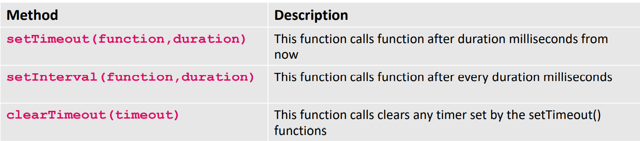
DOM Animation

Slide 21
DOM Nodes
In the context of DOM, every entity in an HTML or XML document is referred to as a Node In JavaScript, all the Nodes are represented as Objects. They have their own properties and methods is DocumentType Node
▪ is an Element Node, so are meta, title, body, h1, p, ul and li Text contents like the title text 'This is a simple HTML document' is a Text Node Some of the Nodes may have children. Like has as children
• Body has as children

Slide 22
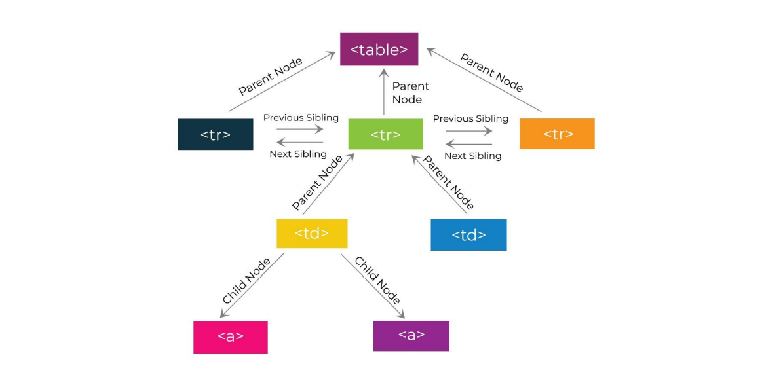
DOM Node – Tree representation - Revisit

Slide 23
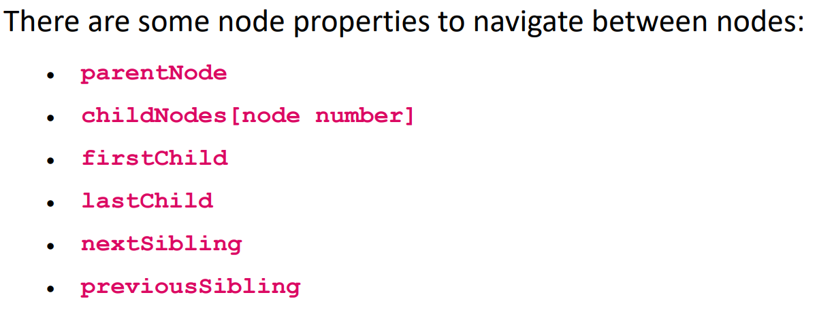
Navigation between nodes

Slide 24
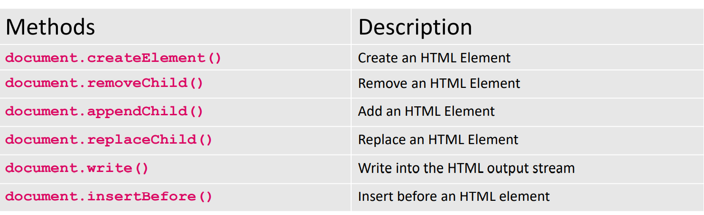
Adding and Deleting Element

Slide 25
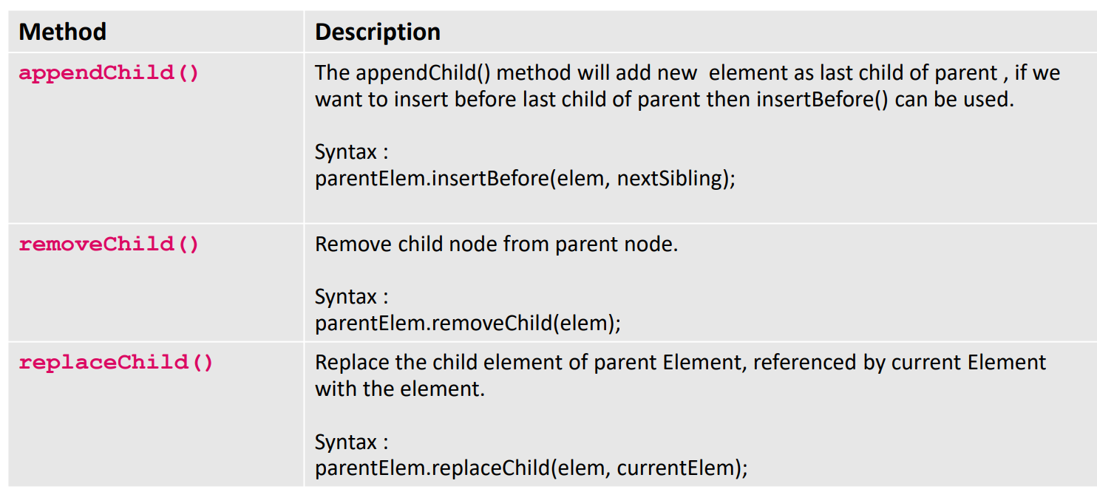
DOM Node - Methods

Slide 26
Attributes
Some element attributes, such as href for links, can be accessed through a property of the same name on the element’s DOM object. This is the case for most commonly used standard attributes.
But HTML allows you to set any attribute you want on nodes. This can be useful because it allows you to store extra information in a document. If you make up your own attribute names, though, such attributes will not be present as properties on the element’s node. Instead, you have to use the getAttribute and setAttribute methods to work with them.

Slide 27
<p data-classified="secret">The launch code is 00000000.</p>
<p data-classified="unclassified">I have two feet.</p>
<script>
let paras = document.body.getElementsByTagName("p");
for (let para of Array.from(paras)) {
if (para.getAttribute("data-classified") == "secret") {
para.remove();
}
}
</script>
Notes:
It is recommended to prefix the names of such made-up attributes with datato
ensure they do not conflict with any other attributes.
There is a commonly used attribute, class, which is a keyword in the
JavaScript language. For historical reasons—some old JavaScript implementations
could not handle property names that matched keywords—the property
used to access this attribute is called className. You can also access it under
its real name, "class", by using the getAttribute and setAttribute methods.

Slide 28
Creating nodes
Say we want to write a script that replaces all images (<img> tags) in the document with the text held in their alt attributes, which specifies an alternative textual representation of the image.
This involves not only removing the images but adding a new text node
to replace them. Text nodes are created with the document.createTextNode method.

Slide 29
// Given:
<div>
<span id="childSpan">foo bar</span>
</div>
// Create an empty element node
// without an ID, any attributes, or any content
var sp1 = document.createElement("span");
// Give it an id attribute called 'newSpan'
sp1.id = "newSpan";
// Create some content for the new element.
var sp1_content = document.createTextNode("new replacement span element.");
Notes:
To get full explained read this article :
https://developer.mozilla.org/en-US/docs/Web/API/Node/replaceChild

Slide 30
// Apply that content to the new element
sp1.appendChild(sp1_content);
// Build a reference to the existing node to be replaced
var sp2 = document.getElementById("childSpan");
var parentDiv = sp2.parentNode;
// Replace existing node sp2 with the new span element sp1
parentDiv.replaceChild(sp1, sp2);
// Result:
<div>
<span id="newSpan">new replacement span element.</span>
</div>

Slide 31
<!-- <script>
var newelement = document.createElement("h1");
newelement.setAttribute("id","newelement");
document.body.appendChild(newelement);
newelement.appendChild(document.createTextNode("Hello World"));
</script> -->

Slide 32
<!-- <script>
for (var i = 0; i < 3; i++) {
var element = document.createElement("p");
element.setAttribute("id","element" + i);
document.body.appendChild(element);
element.appendChild(document.createTextNode("Hello World, I'm Element " + i + "."));
}
var removeel = document.getElementById("element1");
document.body.removeChild(removeel);
</script> -->

Slide 33
Exercise
Write a JavaScript program to modify the text-align, font-size, font-family of heading1 using getElementById •
Write a JavaScript program to change the background color of all the tag •
Write a JavaScript to add the text shadow in all paragraphs in the given essay

Slide 34
End

